Slide 1
STAT 221-fundamentals of STATISTICAL DATA ANALYSIS
Week-14: Correlation and Regression
Shivakumar Jolad

Slide 2
Correlation and regression

Slide 3
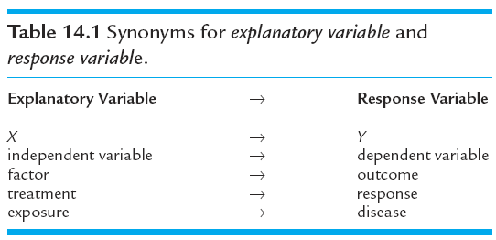
Data
Quantitative explanatory variable X
Quantitative response variable Y
Objective: To quantify the linear relationship between X and Y

Slide 4
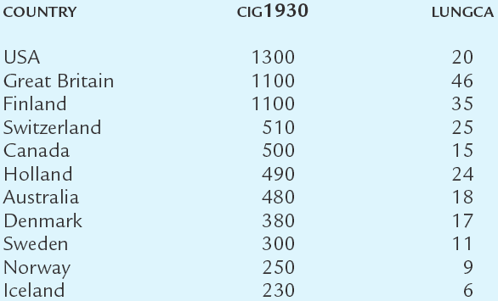
Illustrative Data (Doll, 1955)
per capita cigarette
consumption (X)
lung cancer mortality per
100,000 in 1950 (Y)
per capita cigarette
consumption (X)
n = 11

Slide 5
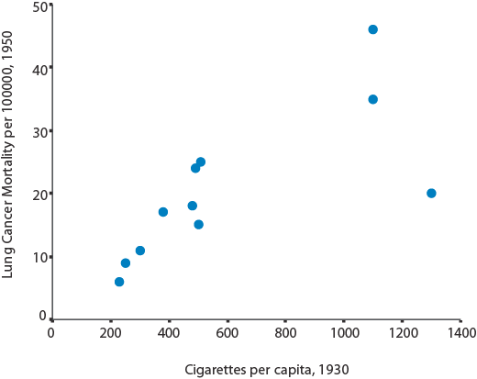
Scatterplot
Assess:
Form
Direction of association
Outliers
Strength of relation

Slide 6
Doll, 1955
Form: linear
Direction: positive association
Outlier?
Strength: difficult to determine by eye

Slide 7
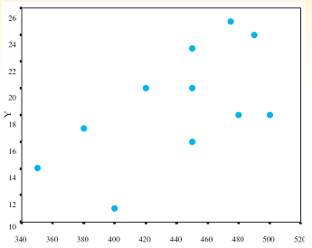
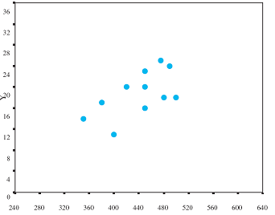
The eye is not a good judge of strength
Identical data sets on differently scaled axes
This relation appears to be weak
This relation appears strong
The different appearances in strength is an artifact of the axis scaling

Slide 8
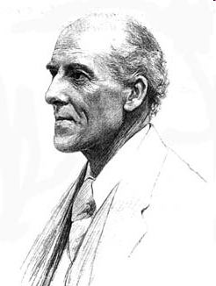
Correlation Coefficient r
r ≡ Pearson’s product-moment correlation coefficient
Measures degree to which X and Y “go together”
Always between −1 and 1
r ≈ 0 ⇒ no correlation
r > 0 ⇒ positive correlation
r < 0 ⇒ negative correlation
Closer r is to 1 or −1, the stronger the correlation
Karl Pearson
1857 - 1936

Slide 9
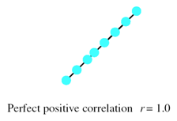
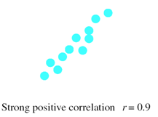
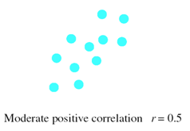
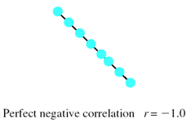
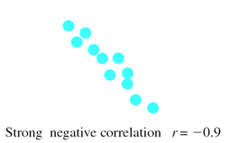
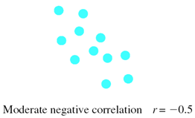
Correlational Direction and Strength

Slide 10
Interpretation of r
Direction of association: positive, negative, ~0
Strength of association
close to 1 or –1 ⇒ “strong”
close to 0 ⇒ “weak”
guidelines
if |r| ≥ .7 ⇒ say “strong”
if |r| ≤ .3 ⇒ say “weak”

Slide 11
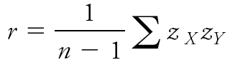
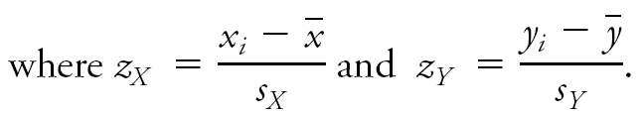
r by hand
z quantify distance above or below mean in standard deviations units.
When z scores track in same directions ⇒ products are positive
When z scores track in opposite directions ⇒ products are negative

Slide 12
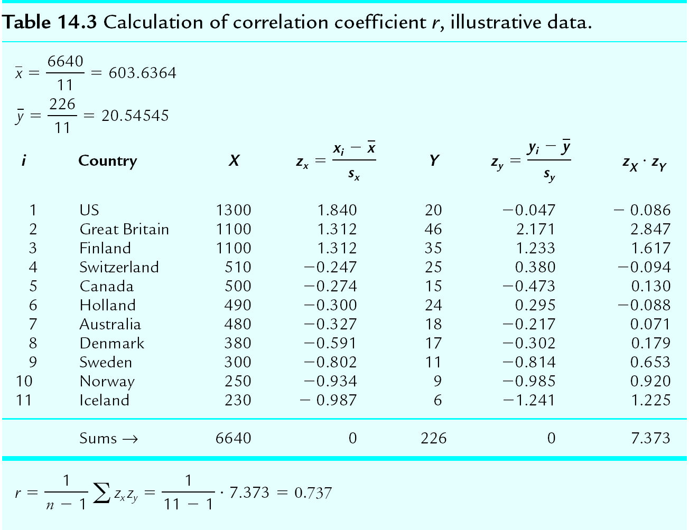
r by hand, Example

Slide 13
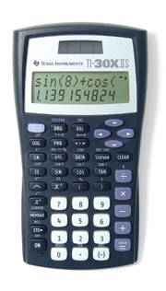

Calculating r
By hand, calculator or computer program
We opt for latter

Slide 14
SPSS output
SPSS > Analyze > Correlate > Bivariate
r
r = 0.74 indicates a strong, positive association

Slide 15
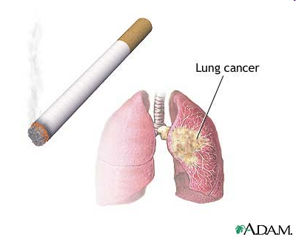
Coefficient of determination (r²)
Square the correlation coefficient ⇒ r² = proportion of variance in Y mathematically explained by X
Illustrative data: r² = 0.737² = 0.54 ⇒ 54% of variance in lung cancer mortality is mathematically explained per capita smoking rates

Slide 16

Cautions
Outliers
Non-linear relations
Confounding (correlation is NOT causation)
Randomness
16

Slide 17
Outliers
Outliers can have profound influence on r
These data have r = 0.82
all because of this guy

Slide 18
Linear Relations Only
r = 0.00
This strong relationship is missed by r because it is not linear

Slide 19
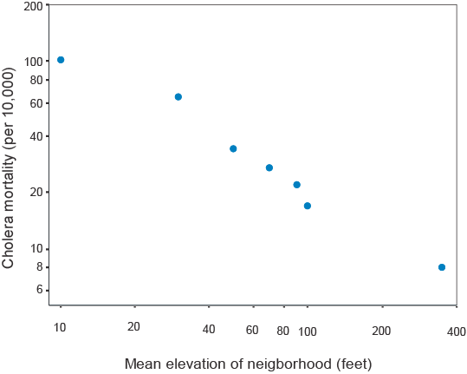
Confounding Correlation ≠ Causation
William Farr showed this strong negative correlation between cholera mortality and elevation above sea level in defense of miasma theory
However, he failed to account for the fact that people who lived at low elevations were more likely to drink from contaminated water sources (∴ confounding)

Slide 20

Don’t be fooled by randomness
Selection of specific data points would result in a false correlation

Slide 21
Hypothesis Test, Steps
Hypotheses. H₀: ρ = 0 vs. H_{a}: ρ ≠ 0 (two-sided) where ρ ≡ population correlation coefficient
B. Test statistic
C. P-value. Convert t_{stat} to P-value Small P ⇒ evidence against H₀

Slide 22
Test, By Hand
H₀: ρ = 0 vs. H_{a}: ρ ≠ 0 (two-sided)
Test stat
C. t table: P < .01 ⇒ strong evidence against H₀

Slide 23
Hypothesis Test
Test the claim H₀: ρ = 0 where ρ ≡ correlation coefficient parameter
SPSS > Analyze > Correlate > Bivariate output:
∴ P = .010 (two-sided) ⇒ reliable evidence against H₀ ⇒ the correlation is statistically significant

Slide 24
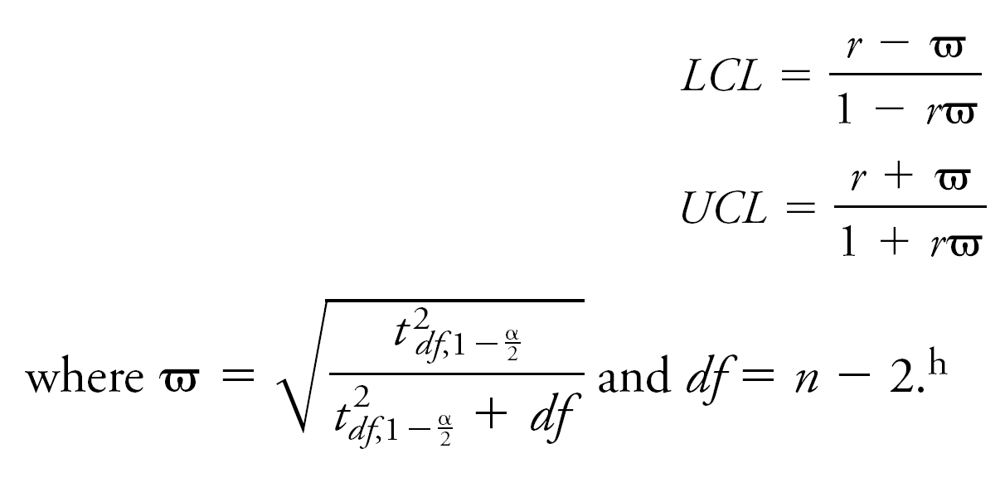

Confidence Interval for ρ

Slide 25
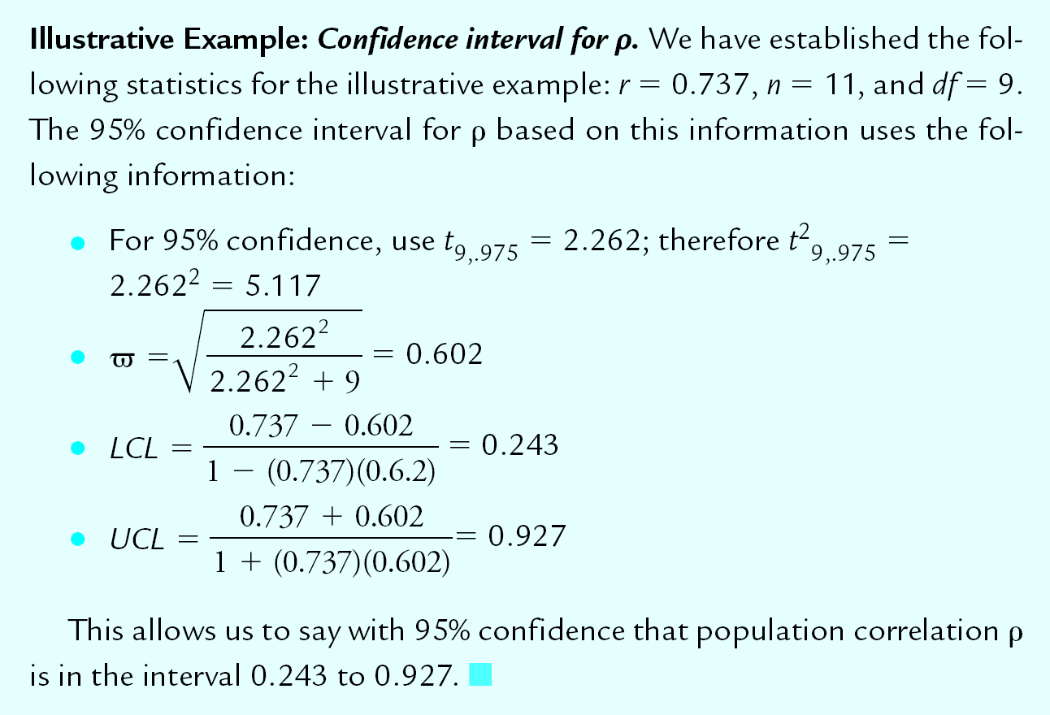
Confidence Interval for ρ

Slide 26
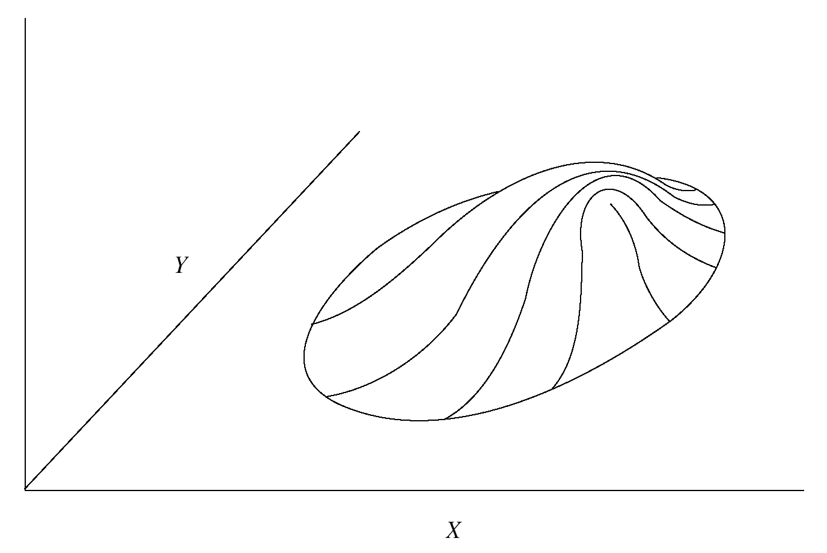
Bivariate Normality
Strictly speaking: P-value requires Normality of the joint distribution of X and Y (“bivariate Normality”)

Slide 27
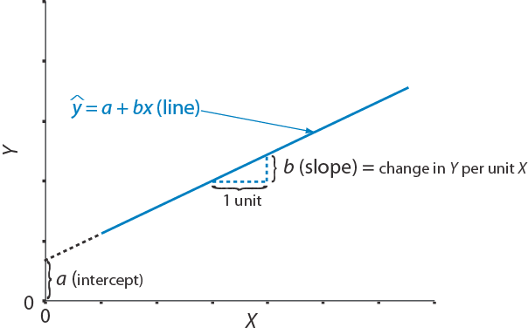
§14.4. Regression
Regression model (equation for line):
ŷ_{i} = a + b∙X_{i}
where
ŷ_{i} ≡ predicted value of Y at x_{i}
a ≡ intercept coefficient
b = slope coefficient

Slide 28
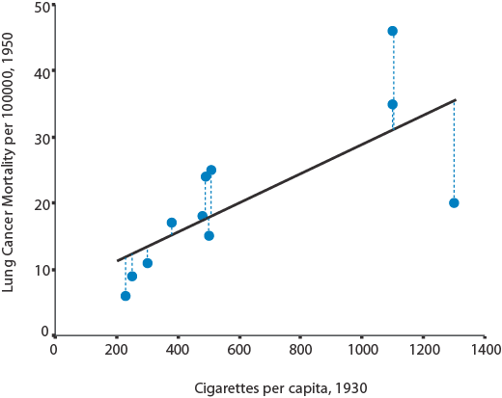
Least Squares Line
Residual ≡ distance of data point from regression line (dotted)
The best fitting line minimizes the residuals
Determine a and b of best fitting line via formula, calculator, or computer.

Slide 29
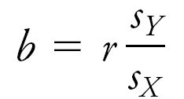

Regression coefficients by hand

Slide 30
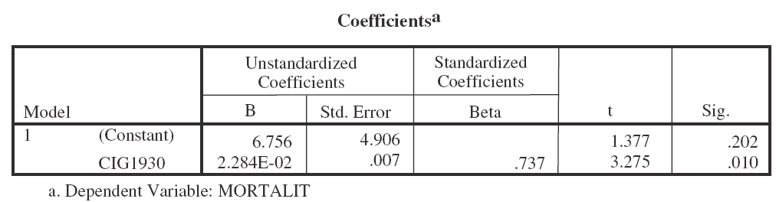
Coefficient by SPSS Analyze > Regression > Linear
Slope estimate (b)
Intercept estimate (a)
Regression line:
ŷ = 6.756 + 0.02284 ∙ X

Slide 31
ŷ = 6.756 + 0.0284 ∙ X
Slope = “rise over run”
.0228 increase per unit X
“Rise” over 200 units
= 200 ∙ .0228
= 5.68
6.756
(intercept)
31

Slide 32
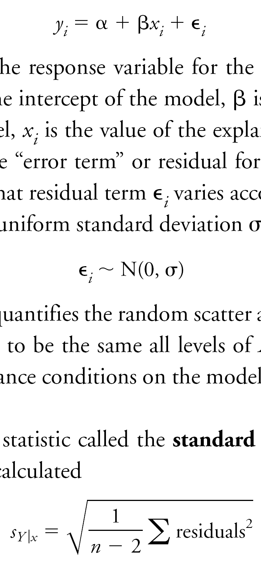
Population Regression Model
where
α ≡ intercept parameter
β ≡ slope parameter
ε_{i} ≡ residual error, observation i
Objective:
To estimate β with (1 – α)100% confidence

Slide 33
CI for β, by hand
Estimated standard error of the regression
(1−α)100% CI for β

Slide 34
CI for β, by hand

Slide 35
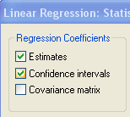
CI for β Analyze > Regression > Linear > Statistics
SPSS statistics options
Dialogue box
95% CI for β
95% CI for β (.007 to.039)

Slide 36
t Test of Slope, by hand
Hypotheses. H₀: β = 0
B. Test statistic.
C. P-value. Interpret in usual manner

Slide 37
Testing H₀: β = 0
t_{stat}
P value
df = n – 2 = 11 – 2 = 9
∴P = .010 ⇒ evidence against H₀ is good
⇒ the slope is statistically significant

Slide 38
Analysis of Variance of the Regression Model
An ANOVA technique equivalent to the t test can also be used to test H₀: β = 0.
This technique is covered on pp. 321 – 324 in the text but is not included in this presentation.

Slide 39
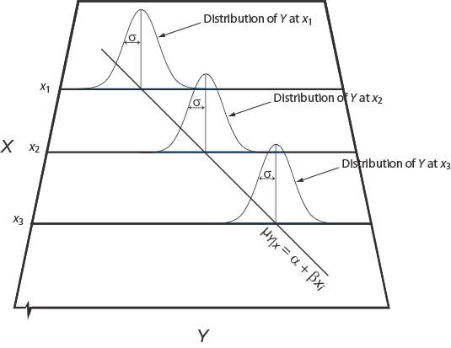
Conditions for Regression Inference
Linearity
Independent observations
Normality
Equal variance (homoscedasticity)

Slide 40
Assessing L.I.N.E
Inspect scatterplot for linearity
Inspect residuals for
linearity
Normality
equal variance

Slide 41
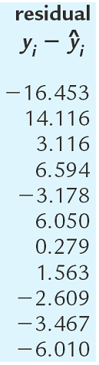
Assessing Conditions
-1|6 -0|2336 0|01366 1|4 x10
no major departures from Normality
⇒
⇒

Slide 42
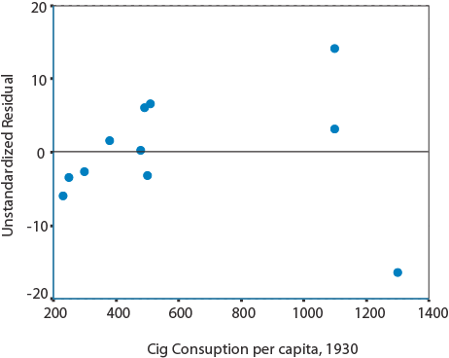
Residual plotted against X values
Data too sparse to assess

Slide 43
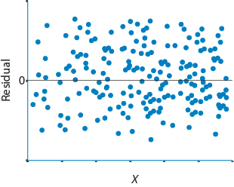
Residual Plot
Example of linearity with equal variance

Slide 44
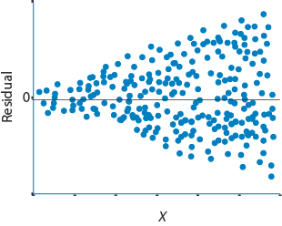
Residual Plot
Example of linearity with unequal variance

Slide 45
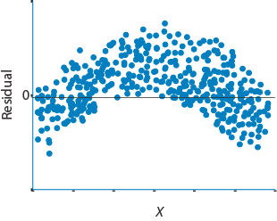
Residual Plot
Example of non-linearity with equal variance

